Slide 1
Context-aware Deep Model for Joint Mobility and Time Prediction
Rao Xuan
2021-9-29

Slide 2
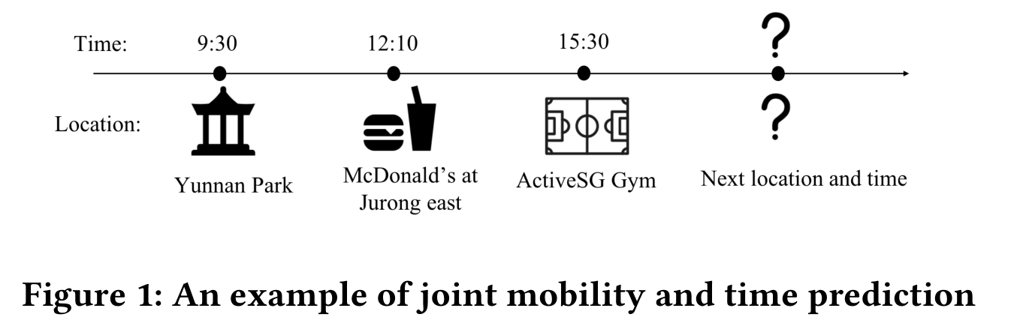
Research direction
propose a novel context-aware deep model called DeepJMT for jointly performing mobility prediction (to know where) and time prediction (to know when)

Slide 3
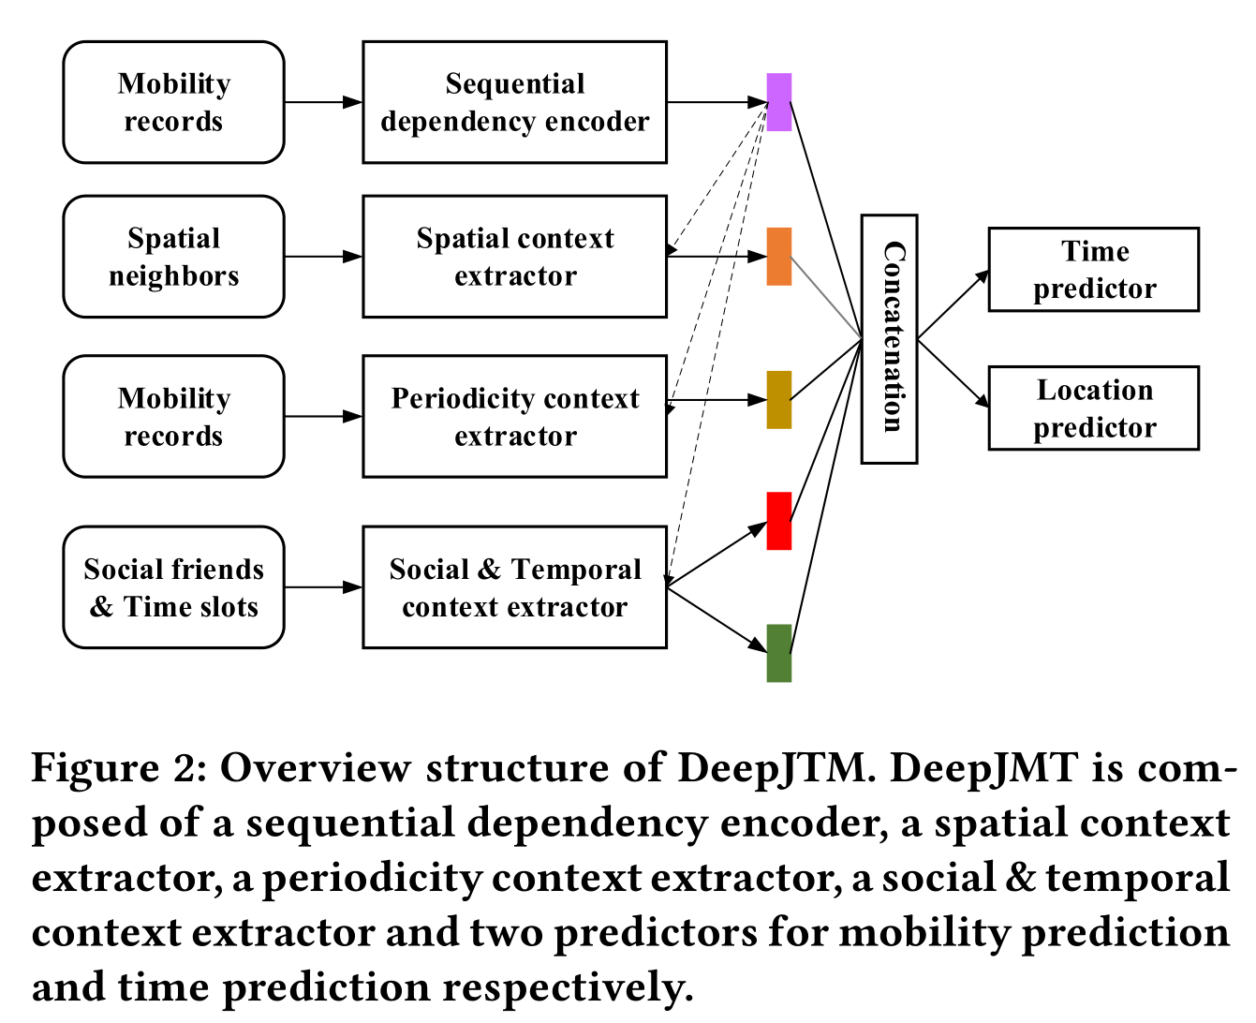
Framework
Sequential dependency encoder: capture a user’s mobility regularities and temporal patterns.
Spatial context extractor: extract user’s location semantics.
Periodicity context extractor: extract user’s periodicity.
Social & temporal context extractor: extract the mobility and temporal evidence from social relationships.

Slide 4
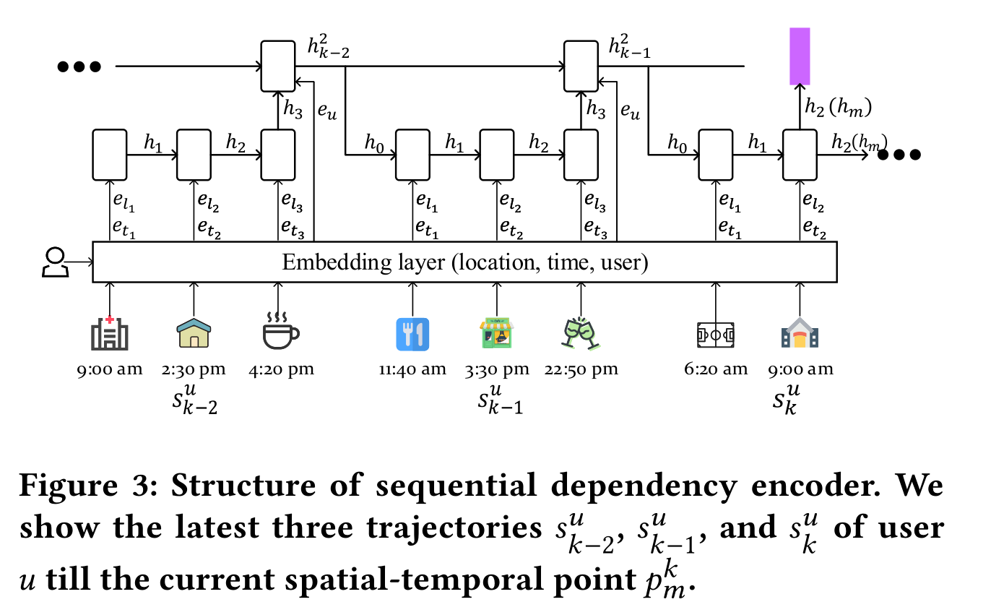
Sequential dependency encoder
M = {p 1 ,p 2 ,..., } : Some user mobility records.
Split the whole mobility records M into non-overlapping trajectories set S,where each element is a subsequence of M .
The maximum time gap between two consecutive points at most 6 hours.

Slide 5
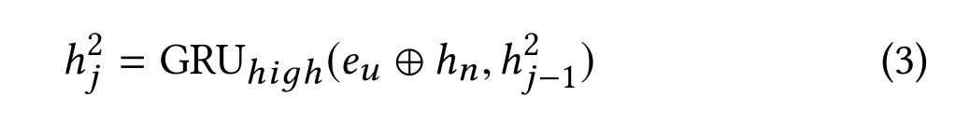
Sequential dependency encoder
The low-level RNN is for modeling transitions within a trajectory.
The last hidden state of the whole trajectory is sent to the high-level RNN.
The high-level RNN is for modeling transitions between trajectories.
The hidden state is then fed to be the initial hidden state of the low-level RNN
Sequential dependency encoder corresponds to a hierarchical recurrent neural network (RNN), where GRU units are used at both the low-level RNN and the high-level RNN.

Slide 6
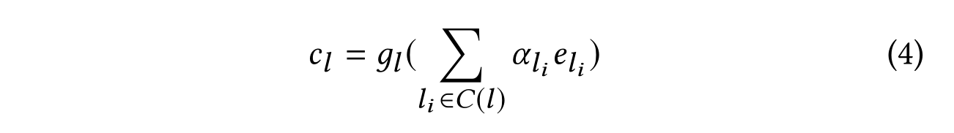
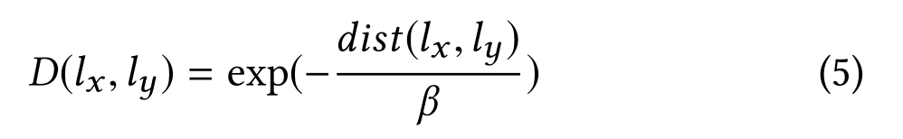
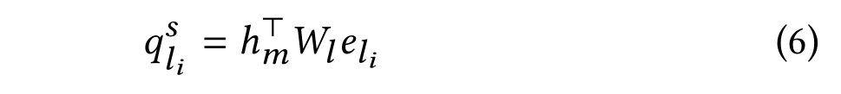
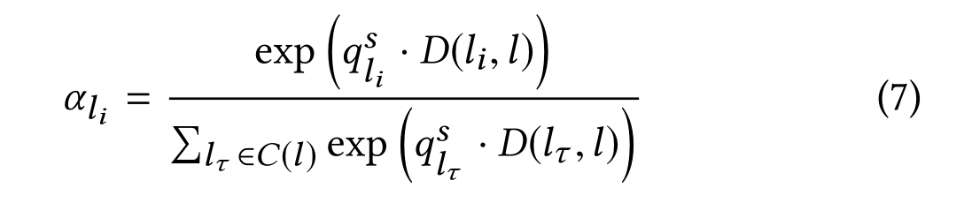
Spatial Context Extractor
Extract the semantics about a user’s current location by leveraging its spatial neighbors
Use both the geographic distances and the dynamic influence for defining the weights.

Slide 7
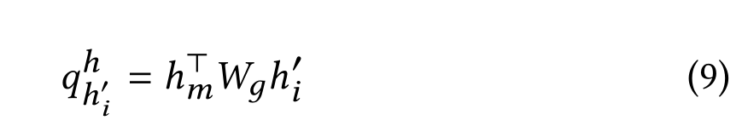
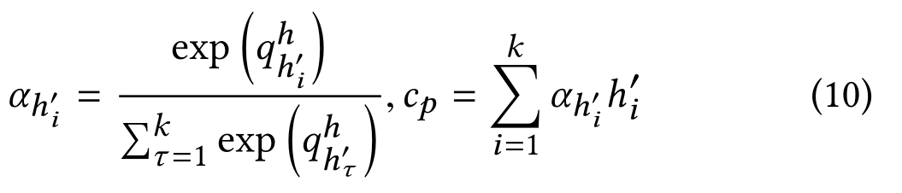
Periodicity Context Extractor
Periodicity phenomenon is reflected by not only the mobility that is close to the current step but also that of steps away.
Use an attention based GRU to extract periodical patterns from mobility records..

Slide 8
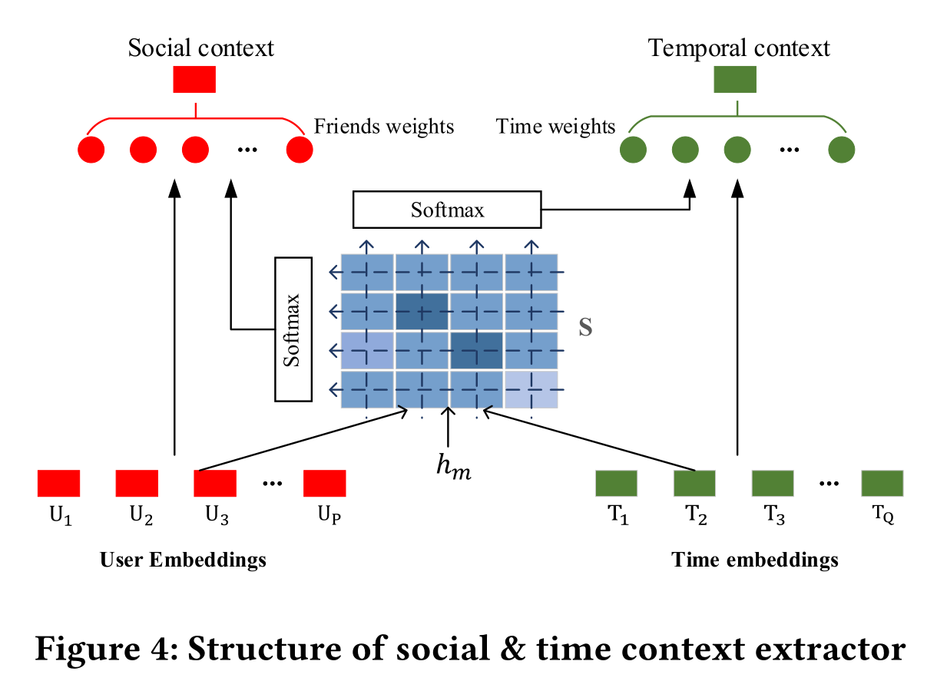
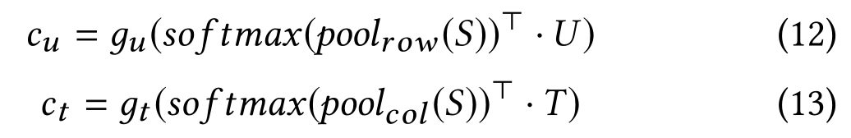
Social & Temporal Context Extractor
Social context captures the aggregated influence on a user from his/her friends based on their similarity.
Temporal context captures a user’s preference on time slots based on his/her friends’ preferences.
Use use co-attention mechanism to jointly reason about the co-attention weights of different user-time pairs.
A score which indicates the influence of user′s i-th friend during time slot j considering user’s current mobility status.
Select the most representative time slot for each friend and the most representative friend for each time slot by max-pooling function.

Slide 9
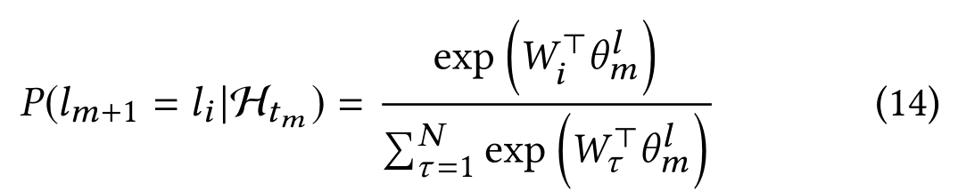
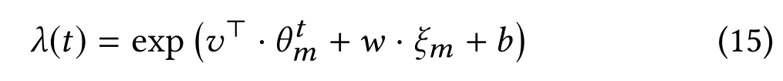
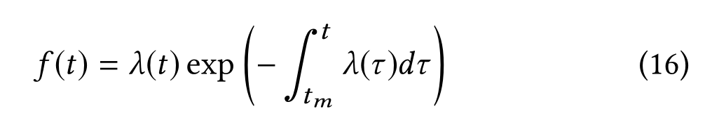
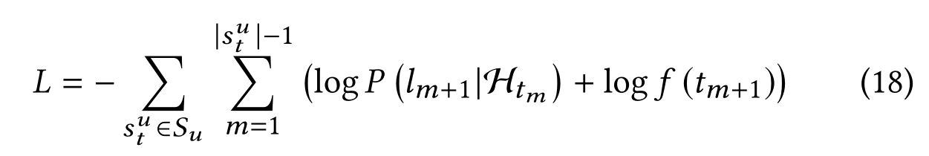
Training and Inference
Training
Compute a probability distribution using a softmax function for mobility prediction.
Model the conditional intensity function using neural networks.
Derive the corresponding conditional density function based on a conditional intensity function.
Define the loss function as a combination of time prediction loss and mobility prediction loss.

Slide 10
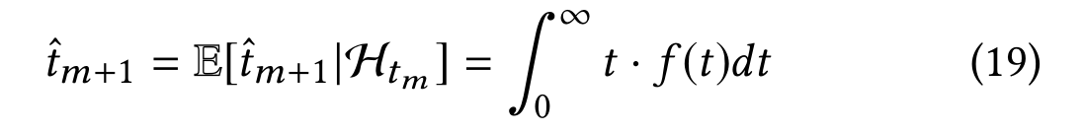
Training and Inference
Inference
Sort and pick top- K locations with the highest probabilities as the predicted locations for mobility prediction.
For time prediction, the predicted time for the next location is calculated using the following integration
The integration does not have a closed-form solution. Use numerical methods to approximate the integration.

